Slide 1

BENV0091 Lecture 3: Introduction to Supervised Learning
Patrick de Mars

Slide 2
Lecture Overview
Tidy Data
Using Facets
Supervised Learning

Slide 3
Setup
Create a new project as usual: lecture3
Download the energy consumption data CSV file from Moodle
Open a new Markdown file and save it as pivot.Rmd

Slide 4
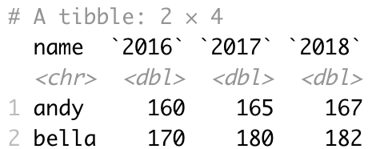
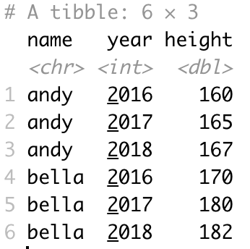
Tidy Data
This data below gives the height of 2 people over 3 years. It is in wide format: a variable (year) is spread across columns – not tidy and hard to plot!
R and especially the tidyverse packages like tidy data
In tidy data:
Every column is a variable
Every row is an observation
Every cell is a single value
Tidy data is easier to plot!
Most commonly, untidy data is in wide format, and should be converted to long format
The data has been tidied using pivot_longer() below

Slide 5
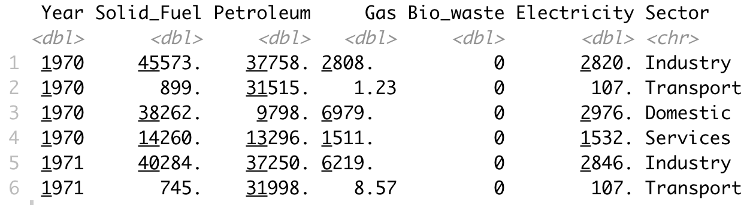
Pivoting
Original data
Read the energy consumption data, assigning to an object named `energy`
How should we transform the data to create the plot on the right?
Task: use pivot_longer() to make the energy data tidy
Task: create the plot on the right with ggplot2 and geom_line()
Use the `linetype` aesthetic

Slide 6
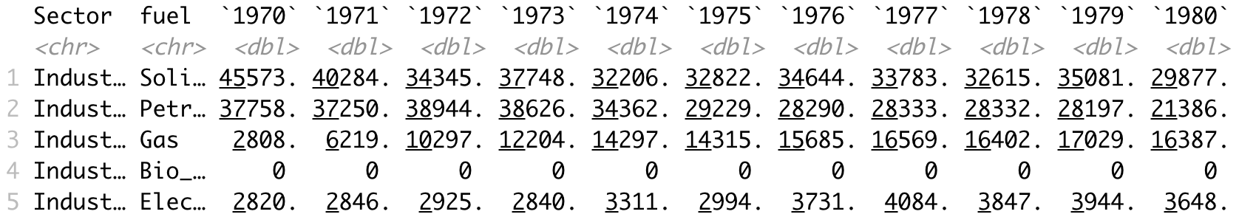
Pivot Wider
pivot_wider() does the opposite of pivot_longer()
You won’t need it so often but it’s good to know
Task: use pivot_wider() to return the pivoted energy data frame back to its original
Task: use pivot_wider() to create a new data frame with the following columns: Sector, fuel, 1970, 1971,…2017 (see below)

Slide 7
Facets
The line plot we made of energy consumption by fuel and sector was pretty busy
There are sometimes advantages to plotting variables on different panels
We can use facet_grid() and facet_wrap() to do this
facet_grid() is used to plot the interaction two variables across rows and columns
facet_wrap() splits the plot across one variable

Slide 8
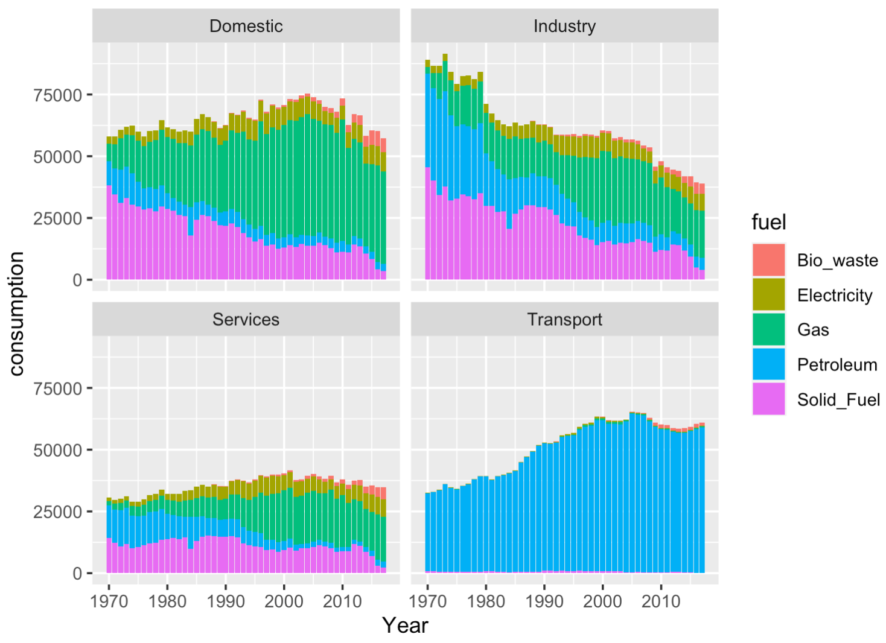
Facets: Wrap
What happened here?
Task: use facet_wrap() to create a bar plot for each sector (see right)
Task: use the `scales` argument to allow each panel to be freely scaled by consumption (each panel has its own y-axis limits)
Task: create a bar plot of consumption vs. year, coloured by Sector, faceted by fuel
Use ggplot(data) + … + facet_wrap(~var) to create a panel for each value of var
You will need geom_col() and the fill aesthetic to colour bars

Slide 9
Facets: Grid
Suppose we want to disaggregate the plot further, seeing each fuel and sector combination separately
Task: use facet_grid() to create a line plot for each fuel and sector (see right)
Task: look carefully at what happens when you set the scales argument to “free”
Task: replace facet_grid() with facet_wrap() and set the y scale to be free
Use facet_wrap(var1 ~ var2) to spread var1 across rows and var2 across columns

Slide 10
Supervised Learning

Slide 11
The Task of Supervised Learning
Supervised learning is the task of fitting a model (function) that maps inputs to outputs based on labelled examples
The most common purposes of a supervised learning model are:
To predict things we don’t have data for:
What will the temperature be tomorrow? (Regression)
What does this image show? (Classification)
To better understand or quantify (possibly causal) relationships between variables:
What are the drivers of fuel poverty?
At a high level, both purposes use the same methods, but some models are less interpretable or have better predictive power than others
Notes:
For causal inference, the model does not need to be accurate if the relationships are statiscally significant

Slide 12
Modelling MPG
We will fit two models on the `mpg` dataset from ggplot2
We will predict the highway MPG (`hwy`) with the following variables: displ, cyl, drv, class
We will try a linear regression model and a decision tree
Task: create a new data frame `df` which has only the following columns:
hwy
displ
cyl
drv

Slide 13
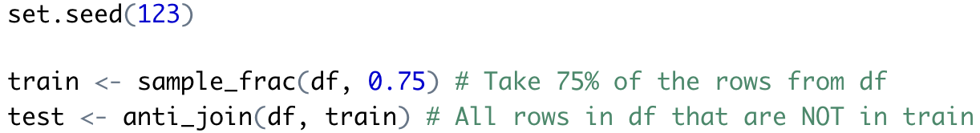
Splitting Data
The models will be trained on a subset of the data (training set), and tested on the remainder (testing set) to determine how well they generalise to new data and avoid overfitting
Task: split the data into `train` (75%) and `test` (25%) sets:
There are several methods: this one uses `sample_frac()` and `anti_join()`:
Use set.seed(x) to set the random seed: this makes your results reproducible
Use sample_frac(df, x/100) to sample x% of rows randomly from df

Slide 14
Dummy Variables
Wrong way!
drv
f
r
4
drv
1
2
3
👎
When dealing with categorical variables (factors), we need to convert them to something which we can deal with numerically
drv has 3 classes: f (front wheel drive); r (rear WD); 4 (4 WD)
We could naively assign these to 3 values (e.g. 1, 2, 3) but this assumes an ordinal characteristic which is not there!
Dummy variables spread N classes across N-1 binary variables, with a 1 indicating the class
R makes dummy variables automatically when fitting a model
Right way!
drv
f
r
4
drvf | drvr
1 | 0
0 | 1
0 | 0
👏
Note that `4` doesn’t have a column: it is the case where all other values are 0

Slide 15
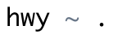
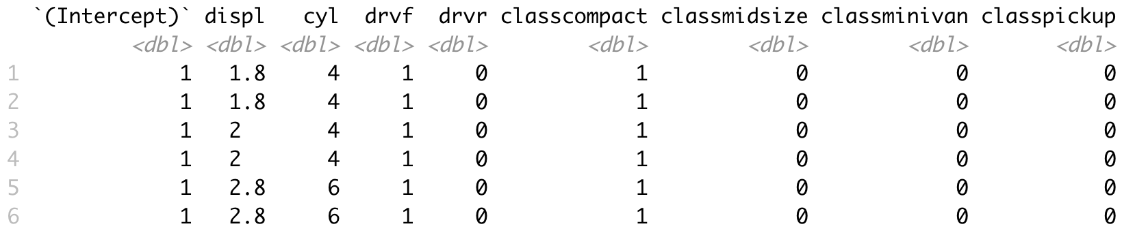
Formulae
Explicit formula
To fit a model, we need to specify a formula
From the modelr package, you can use model_matrix() to see the model equation in matrix form
This will also show you how dummy variables are going to be created
Predict hwy with everything else
modelr::model_matrix(df, formula) returns the model equation explicitly in matrix form

Slide 16
Linear Model
Linear regression models have the form:
Intercept
Coefficient
Noise/residual
$$y=β_{0}+β_{1}x_{1}+β_{2}x_{2}+…+b_{N}x_{N}+ε$$
Dependent variable
Independent variable

Slide 17
Exploratory Analysis
Exploratory plots
Before we fit the models, it’s useful to have some intuition about what we expect to find
Task: reproduce the right hand plot using facet_wrap()
Given the plots on the right, what coefficients do you expect from the model?

Slide 18
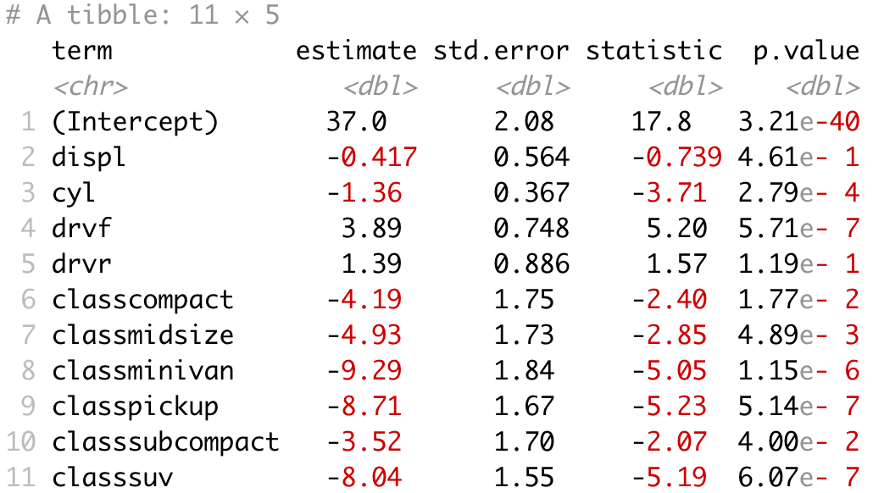
Fitting the Linear Model
We will now fit the linear model using the `lm()` function (which uses ordinary least squares)
Task: fit the model to the training data
We can use `summary(model)` to get some useful information about the model:
Summary statistics about the residuals
Coefficients and p-values
R² value
From the broom package, `tidy()` can be used to summarise information about a model object in a tidy data frame
How do the coefficients and p-values confirm/challenge your expectations?
What can you say about the estimated MPG of 4 wheel-drive cars?
broom::tidy(model) summarises a linear model in a tidy data frame

Slide 19
Fitting the Decision Tree
Use rpart(formula, df) to fit a decision tree for formula, using data df
The mechanics of fitting a model can generally be applied to several model types
Fitting a decision tree with `rpart()` uses the same syntax as `lm()`, although the other arguments are more important too:
Task: fit a decision tree to the model with `rpart()` and:
minsplit = 10
minbucket = 2
cp = 0.01
Plot a decision tree with rpart.plot(dt)

Slide 20
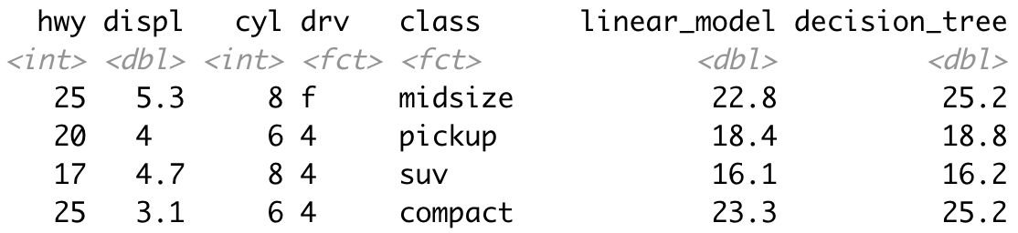
Making Predictions
In R, model objects can be operated on with similar functions:
predict() to make predictions
summary() to see summary statistics
A fitted model object can be applied to make predictions using `predict(model, data)`
Task: use predict() to retrieve the predictions for the linear model and decision tree on the training data
Task: use mutate() to add two columns to the `train` data frame with the linear model and decision tree predictions (like below)
Actual
Precictions

Slide 21
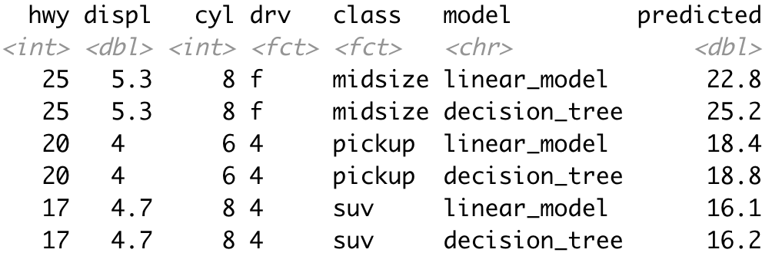
Plotting Residuals
It is important to understand the residuals (difference between predicted and actual values) of your model
Task: use pivot_longer() to make `train` a tidy data frame like the one on the right
Task: add a `residual` column to `train` predicted – hwy
Task: produce a scatterplot of residuals vs. hwy
Residuals are heteroskedastic
Use geom_smooth(method=‘lm’) to add the linear fit
Use facet_wrap(~model) to add a panel for each model

Slide 22
Making Predictions on Test Data
Now we will make predictions on the unseen test data and see which one has the best accuracy
Task: add two columns to the `test` data frame giving predictions from linear model and decision tree using `predict()` (like we did for `train`)
Task: pivot the data frame, creating a `model` column and `predicted` column
Task: plot predicted versus actual values (as in the right hand plot)
Predicted vs. actual
The line y=x on the predicted vs. actual graph indicates perfect predictions

Slide 23
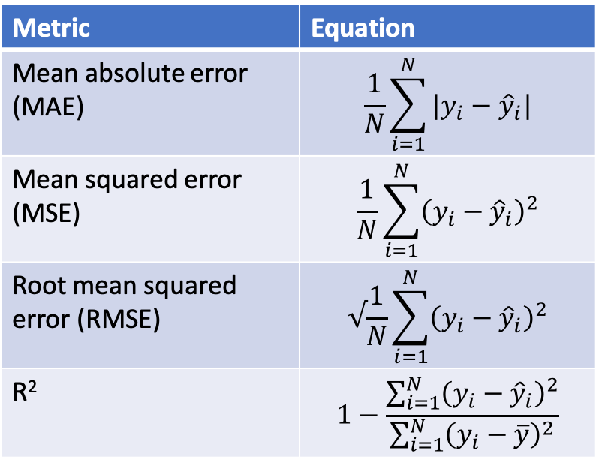
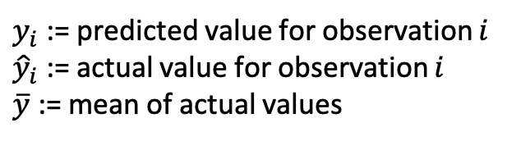
Accuracy Metrics (Regression)
Accuracy metrics for regression
Metric | Equation
Mean absolute error (MAE) | $$\frac{1}{N}\sum_{i=1}^{N}{|y_{i}−{\hat{y}}_{i}|}$$
Mean squared error (MSE) | $$\frac{1}{N}\sum_{i=1}^{N}{{\left(y_{i}−{\hat{y}}_{i}\right)}^{2}}$$
Root mean squared error (RMSE) | $$√\frac{1}{N}\sum_{i=1}^{N}{{\left(y_{i}−{\hat{y}}_{i}\right)}^{2}}$$
R² | $$1−\frac{\sum_{i=1}^{N}{{\left(y_{i}−{\hat{y}}_{i}\right)}^{2}}}{\sum_{i=1}^{N}{{\left(y_{i}−\overline{y}\right)}^{2}}}$$
To compare the two models, we need a quantitative accuracy metric
Common metrics for regression include:
Mean absolute error (MAE)
Mean squared error (MSE)
Root mean squared error (RMSE)
R2 (usually valid for linear models only)
Task: write functions for MAE, RMSE and MAE
Task: use group_by(), summarise(), and your accuracy functions to create a table of accuracy metrics for each model
$y_{i}$ := predicted value for observation $i$
${\hat{y}}_{i}$ := actual value for observation $i$
$\overline{y}$ := mean of actual values

Slide 24
Conclusions
Which model was most accurate?
Which model would you choose to use in practice?
How confident would you be in each model to generalise to new data?
What were the limitations of our approach?
How could our method be improved? Topics for next week!

Slide 25
Mentimeter

